Slide 1
Short-Range Correlations in
Asymmetric Nuclei
Misak Sargsian
Florida International University, Miami
Workshop on Study of High-Density Nuclear Matter with
Hadron Beams
Weizmann Institute, March 28-31, 2017

Slide 2
Abstract:
1. Short-Range Correlations (SRCs) in Nuclei
2. Dominance of the (pn) component in SRCs
3. Two New Properties of Nuclear High Momentum Component
contradicting “conventional” nuclear physics
4. Implications for nuclei and nuclear astrophysics
5. Universality of these Properties for any Asymmetric
Two-Component Fermi System
Interacting only through the Unlike components
at Short Distances

Slide 3
1. Short-Range Correlations in Nuclei
-start with A-body Schroedinger equation interacting through NN -potential
,
,
Amado, 1976

Slide 4
-- IF:
and is finite range
Frankfurt, Strikman 1981

Slide 5
-- The same is true for relativistic equations as:
Bethe-Salpeter or Weinberg Infinite Momentum Frame equations
-- From
follows
Frankfurt, Strikman Phys. Rep, 1988
Day,Frankfurt, Strikman, MS, Phys. Rev. C 1993
- Experimental observations
Egiyan et al, 2002,2006
Fomin et al, 2011

Slide 6
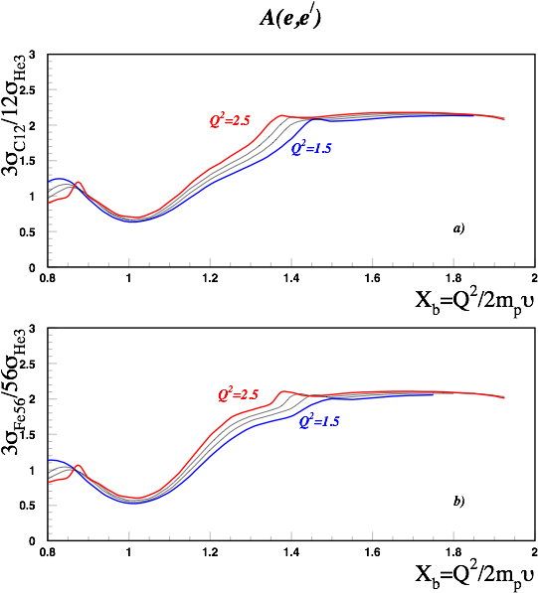
Day, Frankfurt, MS, Strikman, PRC 1993

Slide 7
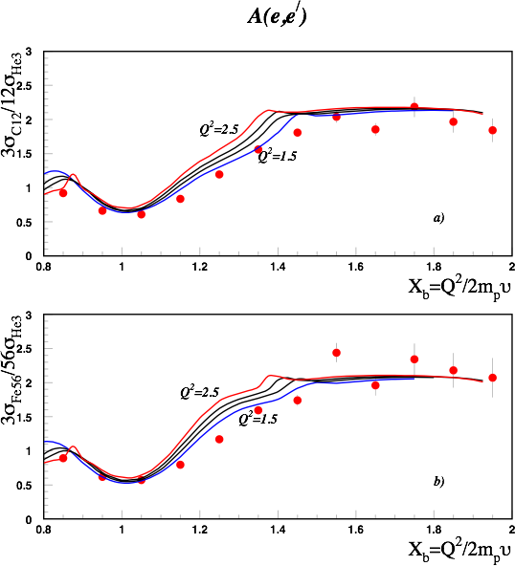
Egiyan, et al PRC 2004

Slide 8
Fomin et al PRL 2011

Slide 9
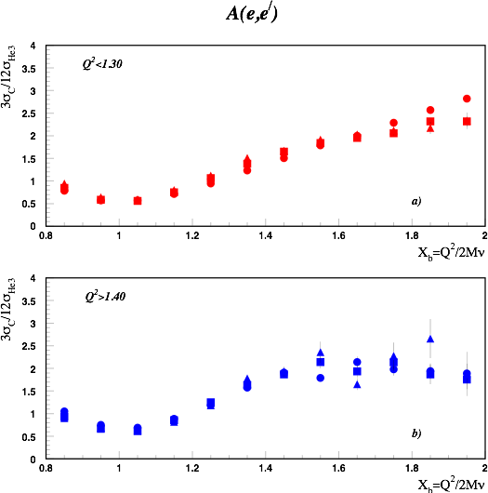

Slide 10


1. Extraction of a2(A,Z) for wide range of Nuclei
Day, Frankfurt, MS, Strikman, PRC 1993
Frankfurt, MS, Strikman, IJMP A 2008
Fomin et al PRL 2011

Slide 11
a2’s as relative probability of 2N SRCs

Slide 12


2. Dominance of the (pn) component of SRC
Theoretical analysis of BNL Data
E. Piasetzky, MS, L. Frankfurt,
M. Strikman,J.Watson PRL , 2006
Direct Measurement at JLab
R.Subdei, et al Science , 2008
pn
Factor of 20
pp
Expected 4
(Wigner counting)

Slide 13
Theoretical Interpretation

Slide 14
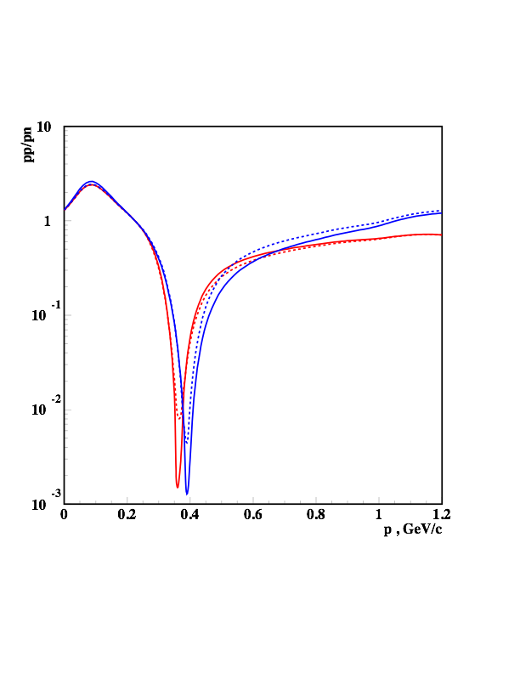
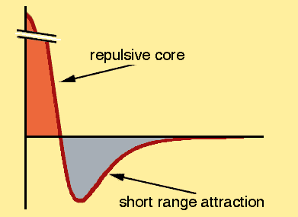
Explanation lies in the dominance of the tensor part in the NN
interaction
Isospin 1 states
M.S, Abrahamyan, Frankfurt,Strikman PRC,2005
Isospin 0 states

Slide 15
Explanation lies in the dominance of the tensor part in the NN
interaction
Isospin 1 states
Sciavilla, Wiringa, Pieper, Carlson PRL,2007
Isospin 0 states

Slide 16
- Dominance of pn short range correlations
as compared to pp and nn SRCS
2006-2008s
Dominance of NN Tensor as compared
to the NN Central Forces at <= 1fm
Two New Properties of High Momentum Component
- Energetic Protons in Neutron Rich Nuclei

Slide 17
3. Two New Properties of Nuclear High Momentum Component
-- Dominance of pn Correlations
(neglecting pp and nn SRCs)

Slide 18
- Define momentum distribution of proton & neutron
- Define
- and observe that in the limit of no pp and nn SRCs
- Neglecting CM motion of SRCs

Slide 19
First Property: Approximate Scaling Relation
-if contributions by pp and nn SRCs are neglected and
the pn SRC is assumed at rest
MS,arXiv:1210.3280
Phys. Rev. C 2014

Slide 20
Realistic 3He Wave Function: Faddeev Equation
MS,PRC 2014

Slide 21
Realistic 3He Wave Function: Correlated Gaussian Basis
T.Neff & W. Horiuchi
April 2013

Slide 22
Be9 Variational Monte Carlo Calculation:
Robert Wiringa 2013
http://www.phy.anl.gov/theory/research/momenta/

Slide 23
B10 Variational Monte Carlo Calculation:
Robert Wiringa

Slide 24
Second Property:
MS,arXiv:1210.3280,2012
Phys. Rev. C 2014
Using Definition:
Approximations:
And:
One Obtains:

Slide 25
Second Property: Fractional Dependence of
High Momentum Component
with
In the limit
Momentum distributions of p & n are inverse
proportional to their fractions

Slide 26
Predictions: High Momentum Fractions
MS,arXiv:1210.3280,2012
Phys. Rev. C 2014
A Pp(%) Pn(%)
12 20 20
27 23 22
56 27 23
197 31 20
Requires dominance of pn SRCs
in heavy neutron reach nuclei
O. Hen et.al. Science, 2014

Slide 27
Predictions: Minority Component has larger high
high momentum fraction:
MS,arXiv:1210.3280,2017
Phys. Rev. C 2014
Checking for He3
Energetic Neutron
(Neff & Horiuchi)
Energetic Neutron

Slide 28
VMC Estimates: Robert Wiringa
MS,arXiv:1210.3280
Phys. Rev. C 2014

Slide 29
Symmetric Nuclei
Asymmetric Nuclei
low momentum
p
n
p
n
high momentum
Conventional Theory:
(Shell Model, HO Ab Initio)
Asymmetric Nuclei
Neutron Stars
New Predictions
1. Per nucleon, more protons
are in high momentum tail
n
p
p
n
2. Kin Energy Inversion
?
Protons my completely
populate the high momentum
tail

Slide 30
- New Properties of High Momentum
Distribution of Nucleons in Asymmetric Nuclei
MS,arXiv:1210.3280.2012
Phys. Rev. C 2014
- Protons are more Energetic in
Neutron Rich High Density Nuclear Matter
M. McGauley, MS
arXiv:1102.3973,2011
- First Experimental Indication
O. Hen, et.al.
Science, 2014,
- Confirmed by VMC calculations for A<12
R.B. Wiringa et al,
Phys. Rev. C 2014
- For Nuclear Matter
W. Dickhoff et al
Phys. Rev. C 2014
- For Medium/Heavy Nuclei
J. Ryckebusch, W.Cosyn
M. Vanhalst., J.Phys 2015J
- In Light-Cone Approximation:
O.Artiles, M.S.
Phys. Rev. C 2016

Slide 31
4.Implications/Predictions for Nuclear Physics and
Astrophysics
- more/less protons/neutrons per nucleon in neutron rich nuclei
protons are extremely energetic in Neutron Stars
protons are more modified in neutron rich nuclei
u-quarks are more modified than d-quarks in large A Nuclei
Experimental Implications:
- Flavor Dependence of EMC effect
- A dependence of NuTev Anomaly
- u/d modification can be checked in neutrino-nuclei or pvDIS
processes
Observational Implications:
Magnetic Field of Neutron Stars

Slide 32
Fraction of High Momentum Protons and Neutrons in Neutron Star

Slide 33
,
,
(1)
Parametric Form
(2)
For
we analyze data for symmetric nuclei
and for other A’s use the relation
where
(3)
Neglecting contributions due to pp and nn SRCs one obtains boundary conditions
M. McGauley, MS Feb. 2011
arxiv 1102.3973

Slide 35
Implications: For Nuclear Matter
- 4 data points
- 2 boundary conditions due
to the neglection of pp/nn
SRCs
-2 more boundary conditions
due to
-1 more positiveness of f(y)

Slide 36
Extrapolation to infinite and superdense nuclear matter
with
C.Ciofi degli Atti, E. Pace, G.Salme, PRC 1991

Slide 37
Asymmetric and superdense nuclear matter:

Slide 38
Implications: For Nuclear Matter

Slide 40
Some Possible Implication of our Results
Cooling of Neutron Star:
Superfluidity of Protons in the Neutron Stars:

Slide 41
Protons in the Neutron Star Cores:
Isospin Locking and Large Masses of Neutron Stars

Slide 42
Are the observed effects universal for any
two-component asymmetric/imbalanced Fermi
Systems?
- In Atomic Physics
- In QCD

Slide 43
Momentum Sharing in Atoms
- Start with Two Component Asymmetric Degenerate Fermi Gas
- Asymmetric:
- Switch on the short-range interaction between two-component
- While interaction within each components is weak
- Spectrum of the small component gas will strongly deform
Cold Atoms
Trapped 2 component gas
diffusion

Slide 44
Momentum Sharing in QCD
- Way of probing qq short range correlations
- In analogy of:
- For valence quarks: Weinberg type LC equations for nucleon
- Observation of
- Observation of
- Predictions:

Slide 45
Wim Coyn, MS PRC 2016

Slide 46
Conclusions and Outlook
Protons and neutrons may have different
high momentum fractions
Implications for Neutron stars dynamics,
EMC effects, ….
Effects can be universal for any two
Component Asymmetric Fermi system
In QCD it can be used to probe signatures of
qq correlations

Slide 47
2N SRC model
Non Relativistic Approximation

