Slide 1
Femtoscopic correlations of pions and kaons measured in the BES program at STAR (and not only at STAR)
Grigory Nigmatkulov
National Research Nuclear University MEPhI
Study of high-density nuclear matter with hadron beams
Weizmann Institute of Science
March 28-31, 2017

Slide 2
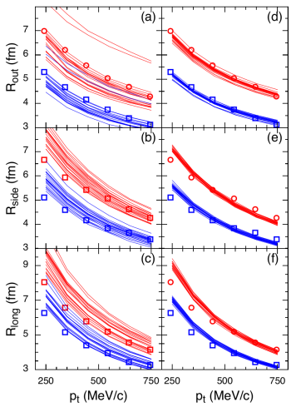
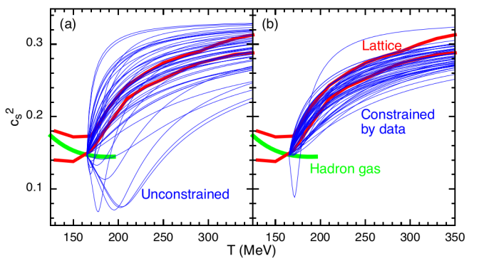
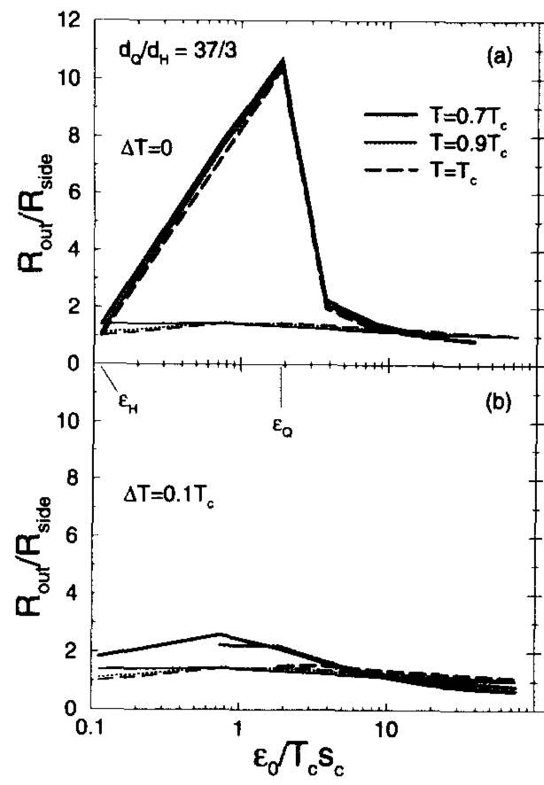
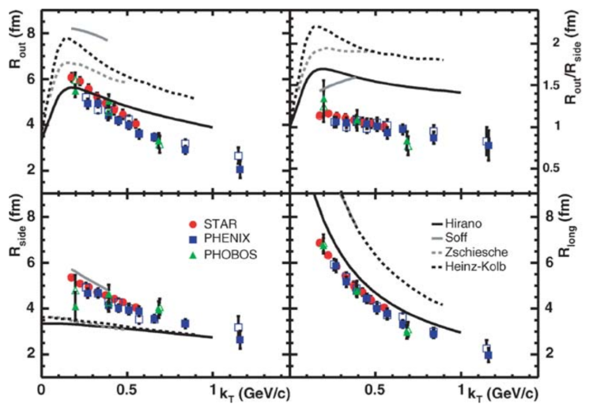
Motivations
Allows to study space-time structure of the produced collective system of self-interacting matter (also see T. Csörgő talk)
Very important in HI collisions:
Constraining Equation of State S. Pratt et al. PRL 114 (2015) 202301
Constraining hydro/transport M.A. Lisa et al. Ann. Rev. Nucl. Part. Sci. 55 (2005) 357
Sensitivity to the phase transition D.H. Rischke, M. Gyulassy. NPA 608 (1996) 479

Slide 3
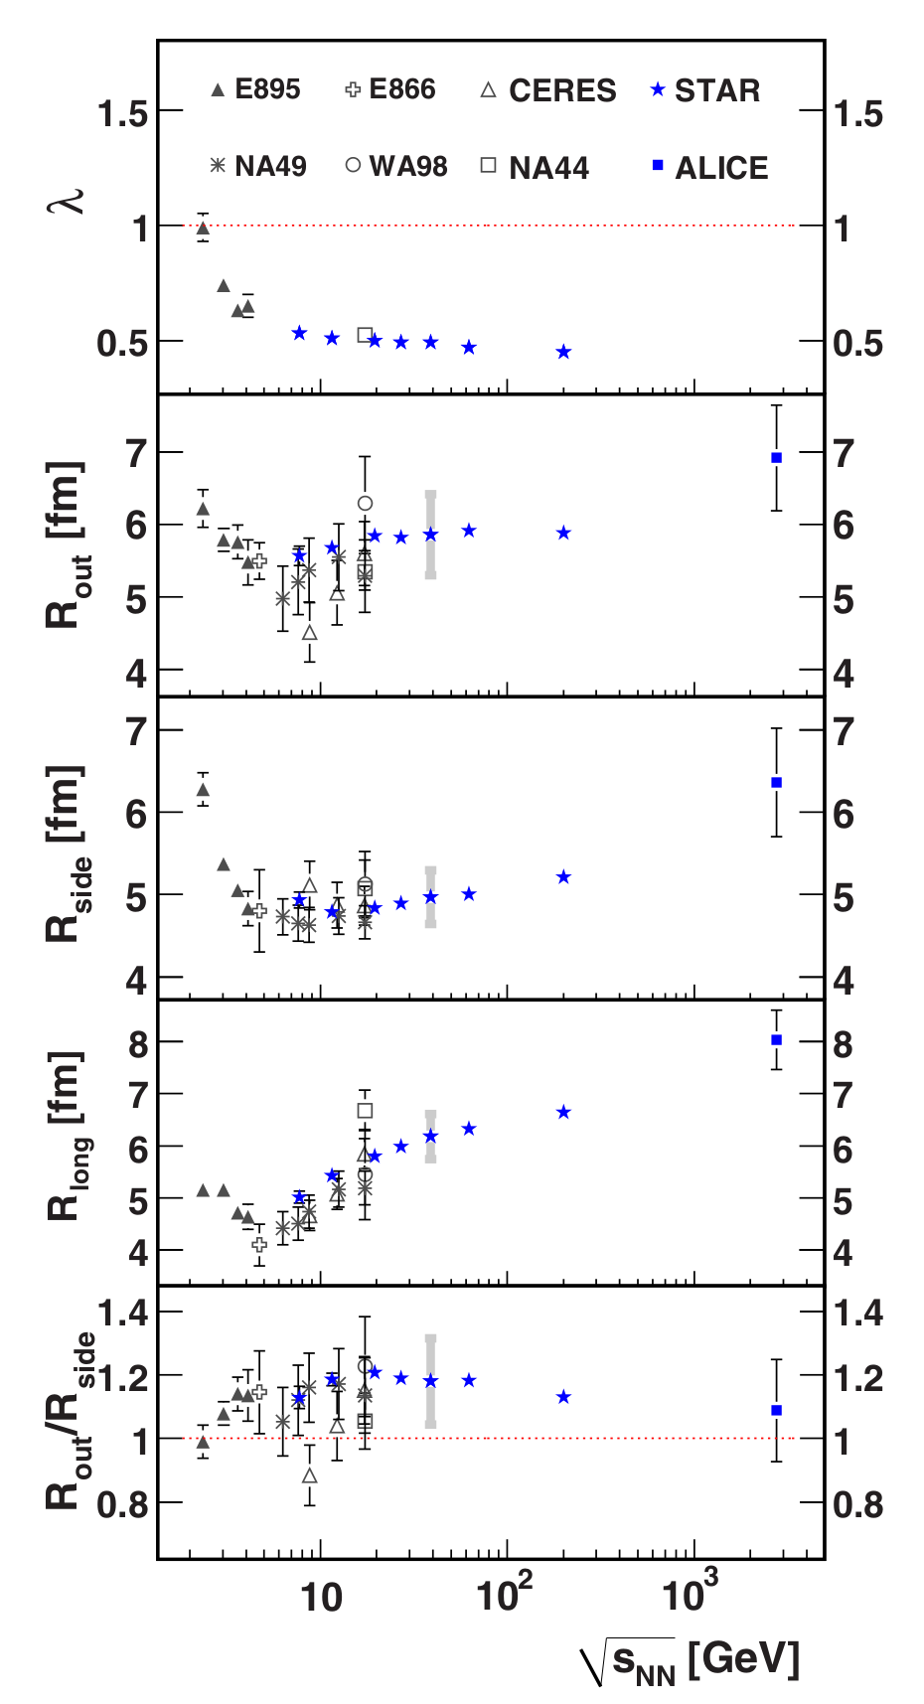
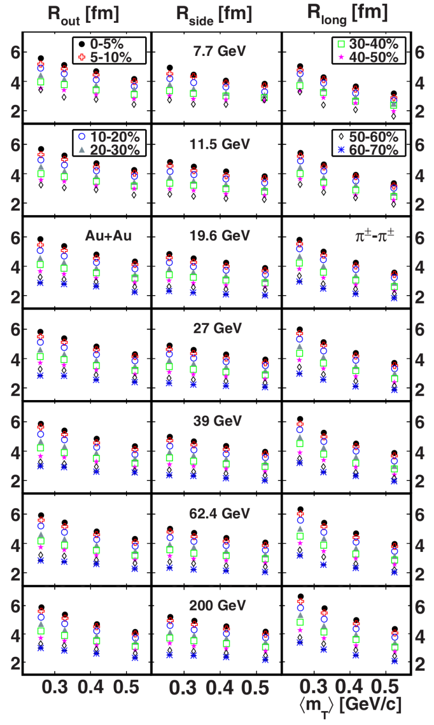
Pion femtoscopy from STAR
Precise measurement in a broad energy range (from 7.7 to 200 GeV) using the same detector, techniques, etc. STAR, PRC 92 (2015) 014904
Centrality and transverse mass dependencies
Consistency of the results from fixed target and collider experiments in a wide energy range

Slide 4
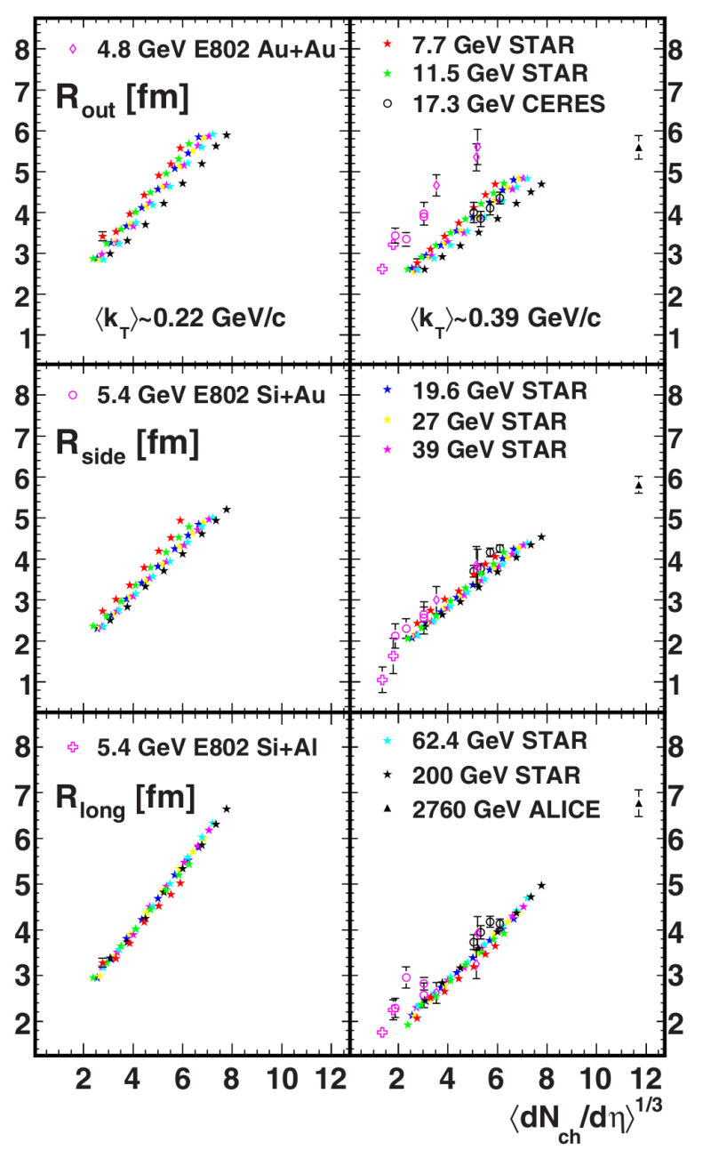
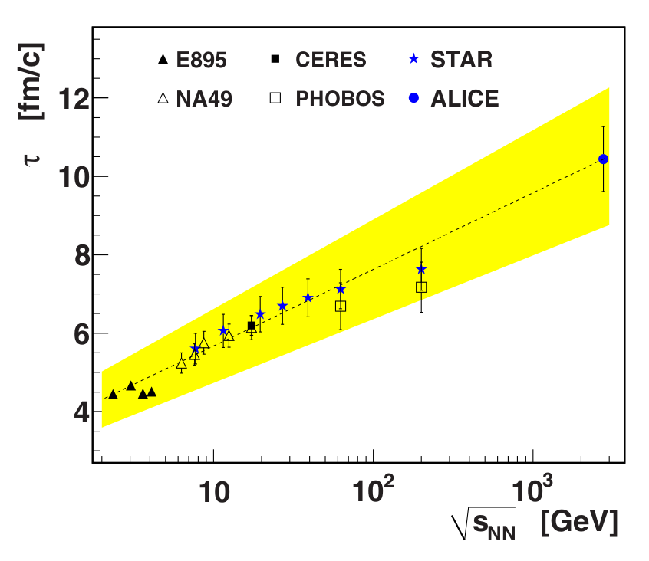
Importance of the collision energy scans
Radial flow & emission duration
Space and time scale as ~multiplicity^{1/3}
The created system lives longer, however no sudden jumps in timescales in R_{L}
Radial flow
Longitudinal flow ~ evolution time
STAR, PRC 92 (2015) 014904

Slide 5
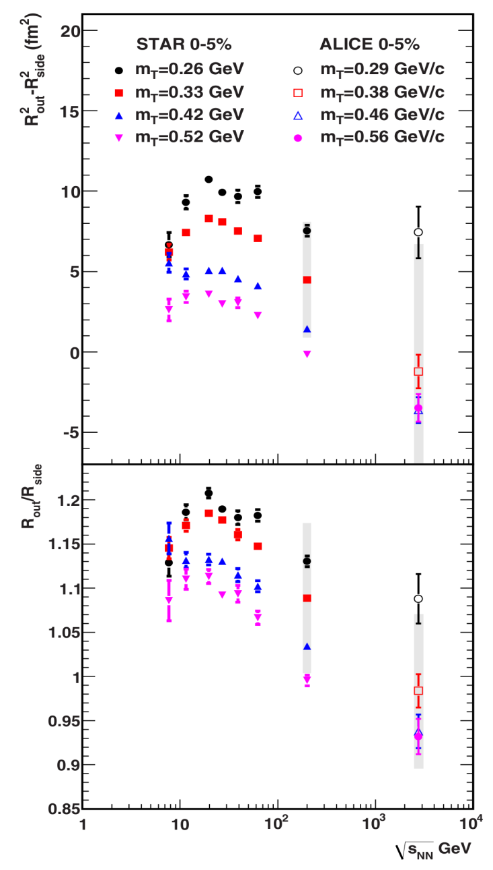
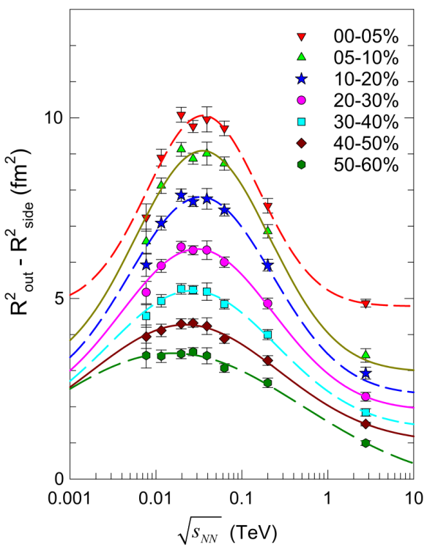
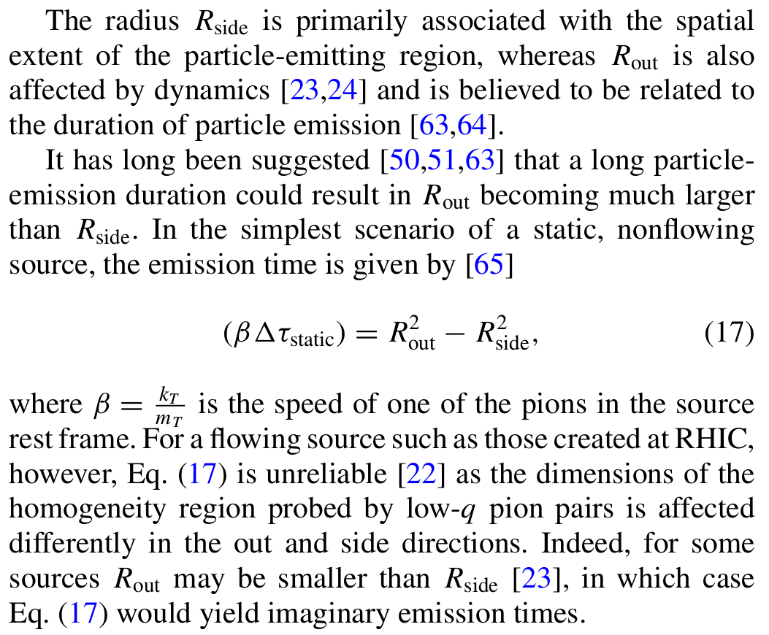
Importance of the Beam Energy Scan
Finite-size scaling:
At critical point, susceptibilities diverge for infinite system → delta function
For finite system:
No divergence
Peaking at CP and shift of the peak position
Broadened peaks
STAR, PRC 92 (2015) 014904
R. Lacey. PRL 114 (2015) 142301

Slide 6
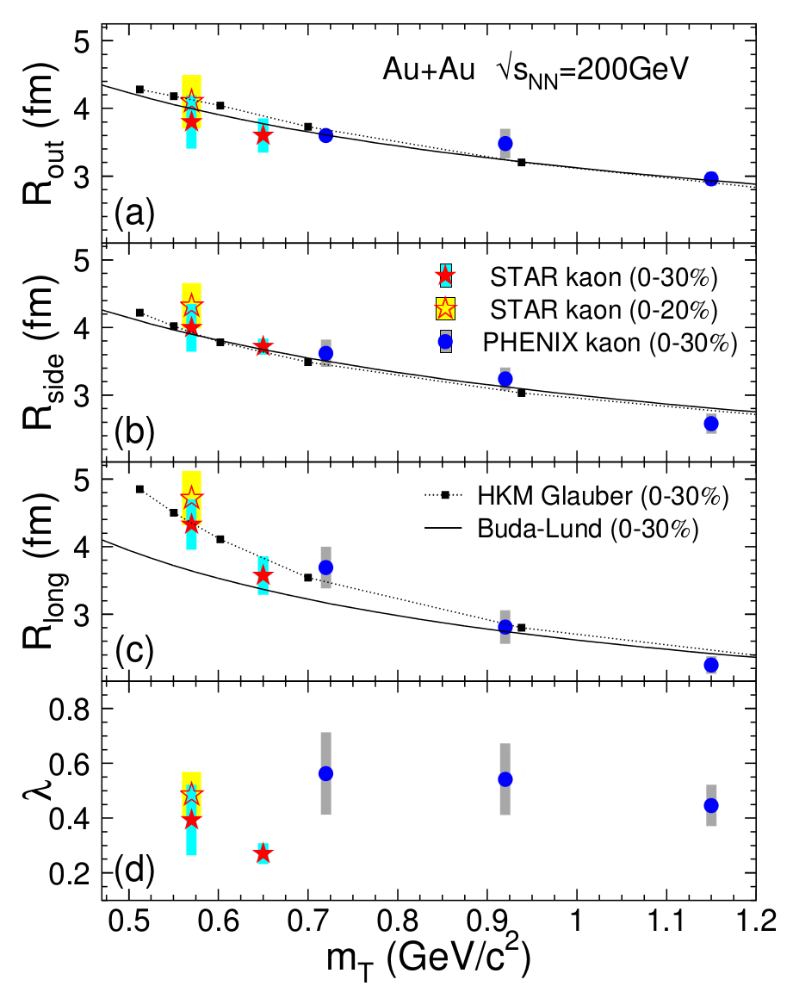
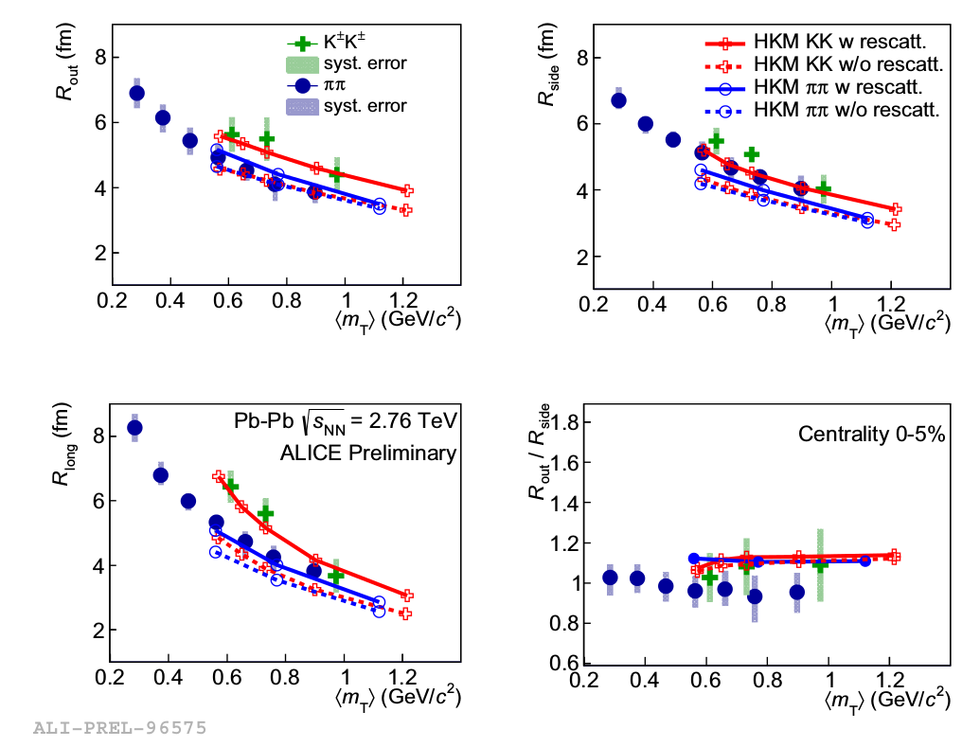
Different particle species
Provide additional information
Check for m_{T} dependence → determine freeze-out conditions
Model constrains: should work for heavier particles
Possibility to distinguish between different model scenarios
Malinina (QM’15) NPA 956 (2016) 373
PHENIX, PRL 103 (2009) 142301
STAR, PRC 88 (2013) 034906

Slide 7
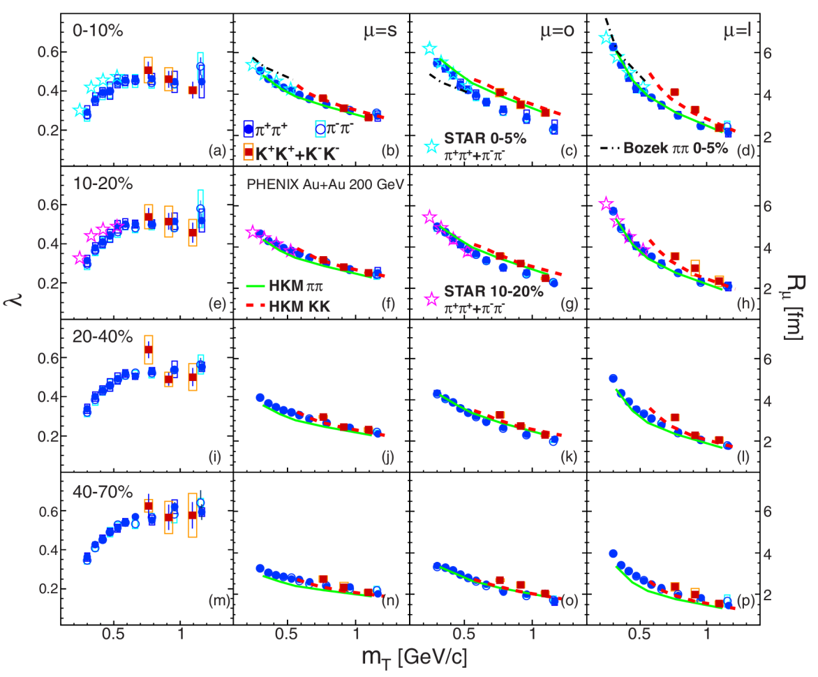
Kaon femtoscopy at RHIC
m_{T}-scaling breaks for individual radii
Longer emission duration of kaons than of pions
Models cannot describe the differences in the outward direction well
STAR also observes the m_{T}-scaling breaking
PHENIX, PRC 92 (2015) 034914
J. Lidrych (for the STAR collab.) QM 2017

Slide 8
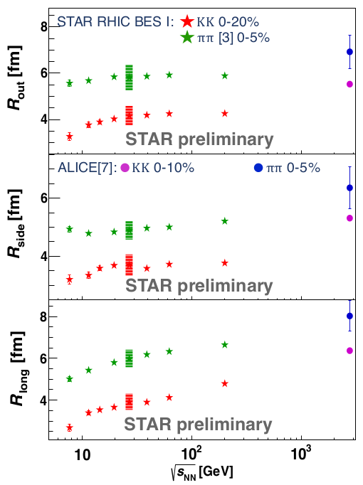
Kaon femtoscopy at RHIC
Comparison of K⁺ and K⁻ radii (should be the same for high-energy collisions)
What about low energies? K⁺N cross-section is smaller than K⁻N.
J. Lidrych (for the STAR collab.) QM 2017
Energy dependence of kaon source radii is similar to pions
J. Lidrych (for the STAR collab.) QM’17

Slide 9
Summary
Pion femtoscopy is a precise tool:
Femtoscopic radii are consistent for collider and fixed target experiments
System lives longer at high collision energies
Interesting behavior from Beam Energy Scan program
Kaon femtoscopy
Additional constrains on the models
Breaking of the m_{T}-scaling for individual directions
No differences between positive and negative kaon emission region for low energies

