Slide 1





Chiral Magnetic Effect in heavy ion collisions and small systems
Fuqiang Wang
Purdue University, Huzhou University

Slide 2
Outline
Brief introduction to CME
Current measurements
  Heavy ions
  Small systems
Backgrounds
  Resonance decays
  Hijing jets
Ways to reduce backgrounds
Summary

Slide 3
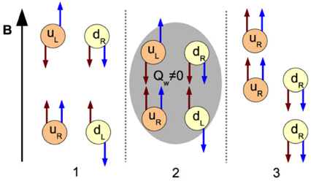




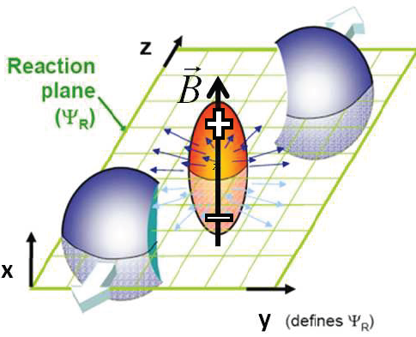
Brief introduction
Chiral Magnetic Effect (CME)
Kharzeev, Pisarski, Tytgat, PRL 81 (1998) 512; Kharzeev, et al. NPA 803 (2008) 227
Non-conservation of axial currents. Axial Ward-identity
Peak magnetic field ~ 10¹⁵ T !
Electric charge separation along the B field
3 / 19
Notes:
QCD真空存在比较丰富的结构，可以用拓扑电荷来量化各种态之间的变化，由于涨落的原因，在重离子碰撞中形成的QGP里，存在一些局域的非零的拓扑电荷，这些拓扑电荷的存在会产生一个非零的轴矢量流，导致净的手征荷的变化，比如说左手粒子变为右手粒子，粒子手征性的变化可以通过改变自旋方向或者动量方向，考虑到在非对心的重离子碰撞中，可能会形成非常强的磁场，自旋和磁场的耦合能量大于粒子的动能，因此在这种情况下，更容易通过改变运动方向来改变手征性，最终的结果就会导致u或d夸克朝同一个方向跑，就会产生一个电荷分离的效应，这个就是手征磁效应。

Slide 4
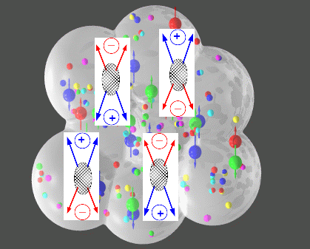
Brief introduction
Three-particle correlator observable
Voloshin, PRC 70 (2004) 057901
Kharzeev, PLB 633 (2006) 260
Kharzeev, McLerran, Warringa, NPA 803 (2008) 227
CME + P-odd domain → charge separation across RP
A direct measurement of the P-odd “a” should yield zero
Directed flow: known to be small; expected to be the same for SS and OS
P-even quantity: what we are looking for; sensitive to charge separation
Non-flow/non-parity effects: The hope was that these cancel out

Slide 5
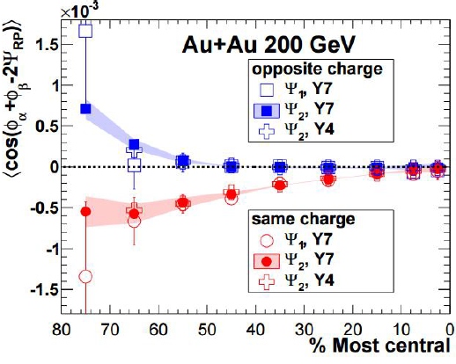
Current measurements
Charge “separation” signal @STAR
STAR, PRL 103 (2009) 251601; PRC 81 (2010) 054908; PRC 88 (2013) 064911
Correlator indicates “charge separation” signal, consistent with CME.
Consistent results using 1st-order EP (from spectator neutron v₁).

Slide 6
Beam energy dependence
Current measurements
STAR, PRL 113 (2014) 052302
ALICE, arXiv:1207.0900
Weak energy dependence from 2.76 TeV to 7.7 GeV. Start to disappear at 7.7 GeV.

Slide 7
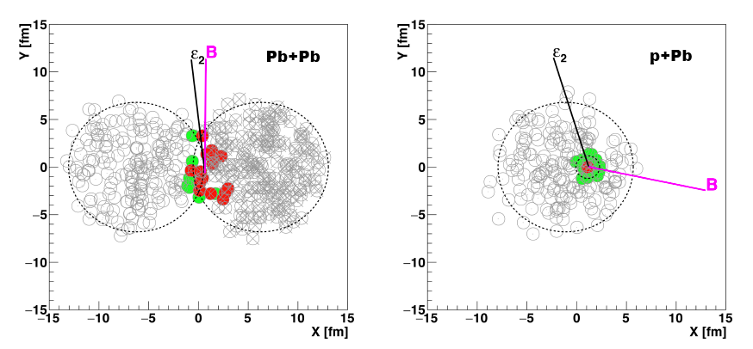
Heavy ions vs. small systems
Current measurements
CMS, arXiv:1610.00263; Belmont, Nagle, arXiv:1610.07964 [nucl-th]
In heavy ion collisions, B-field direction perp. to participant plane (ψ₂) on average.
In small systems, ψ₂ (purely fluctuations) is random w.r.t. b-direction. →
CME signal would be zero in small systems. Any correlation would be background.

Slide 8
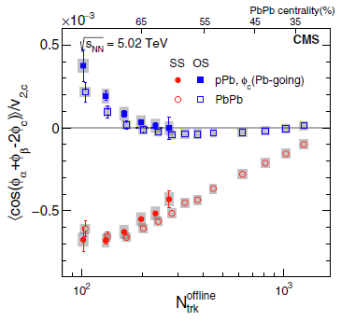
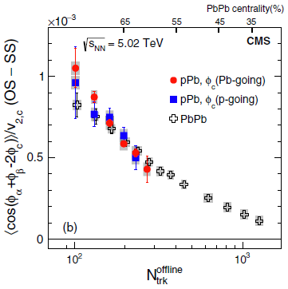
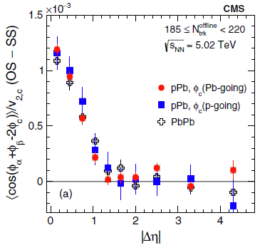
Current measurements
Small system signal @CMS
CMS, PRL 118 (2017) 122301, arXiv:1610.00263
Large non-CME background in pPb.
pPb & PbPb almost identical, suggesting common underlying mechanism.
Challenge the CME interpretation for the heavy ion data at RHIC & LHC.

Slide 9
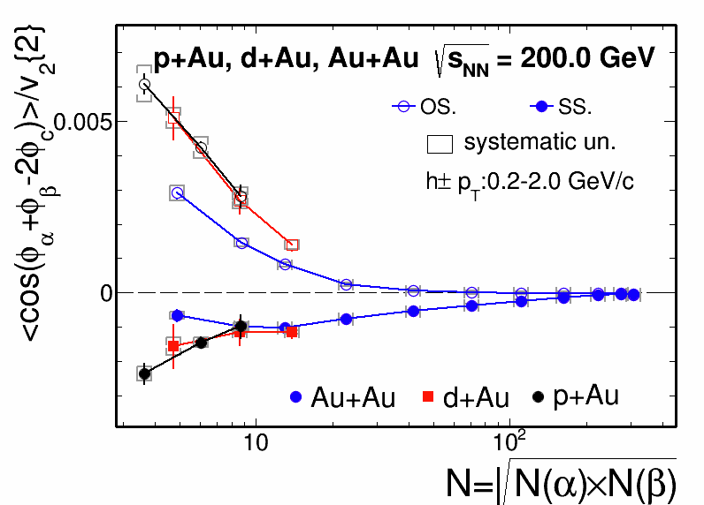
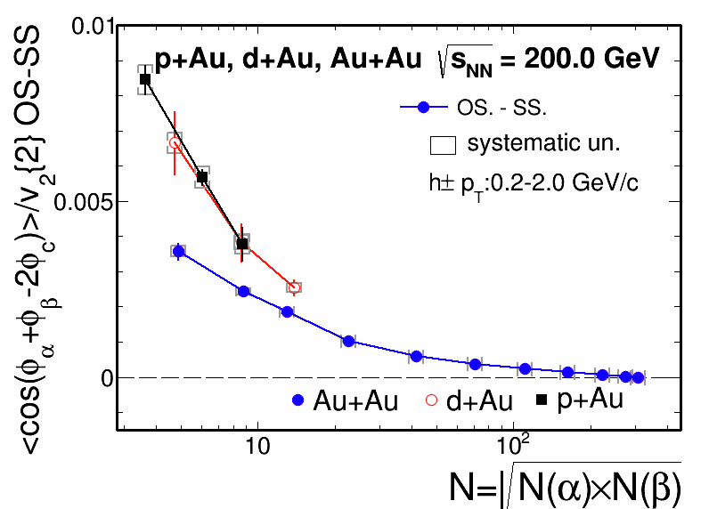
Current measurements
Small systems @STAR
Jie Zhao (STAR), Quark Matter 2017
At same multiplicity p+Au and d+Au are equal, and similar to Au+Au.
p+Au & d+Au data are all background (ψ₂ & b are random), not CME.

Slide 10
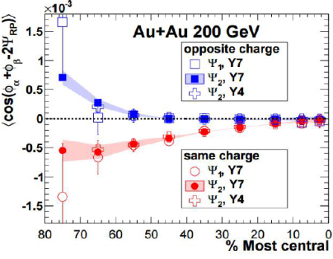
Backgrounds
So… Backgrounds!
CME
+ momentum conserv.
OS
CME
SS
→ Use OS-SS
OS
SS
CME
+ momentum conserv.
+ charge conserv.
OS
π⁺
ρ
π⁺
Voloshin 2004
FW 2009
Bzdak, Koch, Liao 2010
Pratt, Schlichting 2010
……
π⁻
SS
Signal is ambiguous
π⁻

Slide 11
v2-driven background
Backgrounds
Voloshin 2004; FW 2009; Bzdak, Koch, Liao 2010; Pratt, Schlichting 2010; …
Y
π⁻
π⁺
π⁺
ρ
π⁺
ρ
π⁻
X
ψ_{RP}
ρ
π⁺
π⁻
Background: nonflow coupled with flow
π⁻

Slide 12

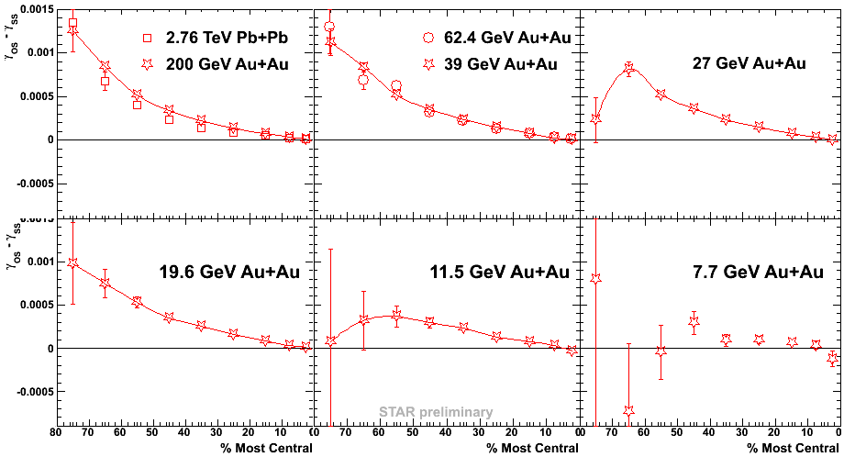
Simple resonance decay estimate
Backgrounds
Voloshin, 2004
0.17/100*0.65*0.1 ~ 10⁻⁴

Slide 13
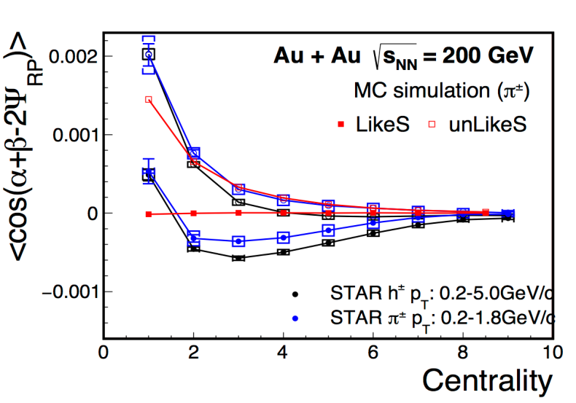
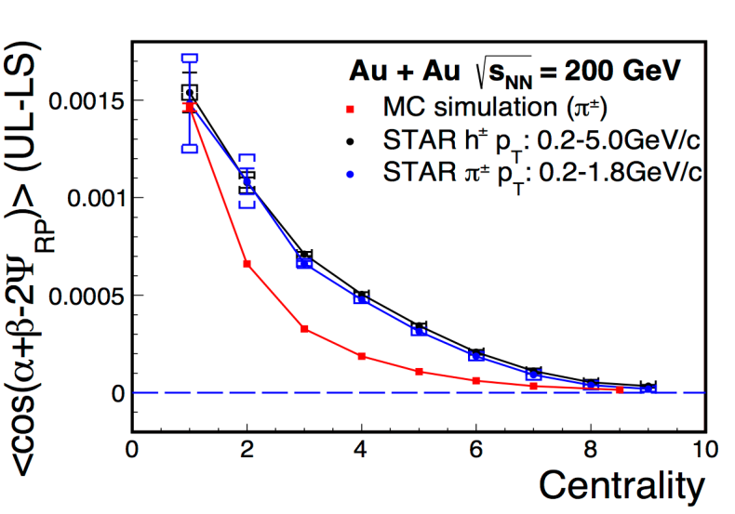
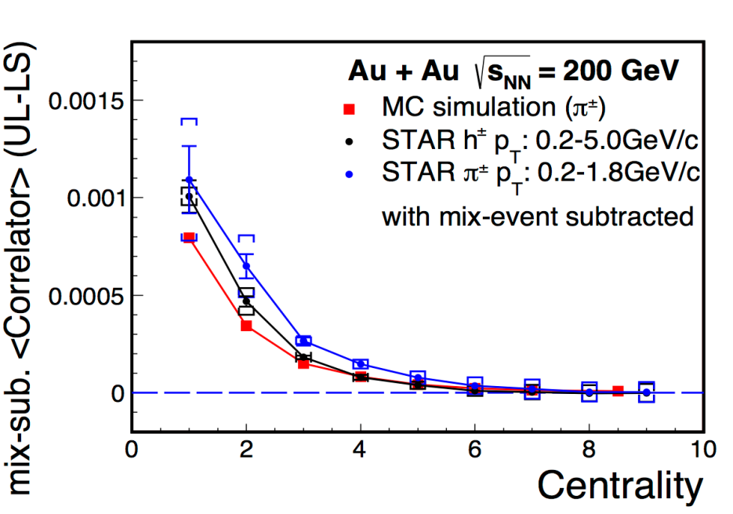
Backgrounds
Resonances decay toy simulation
Toy model
FW, Jie Zhao, arXiv:1608.06610
Mix α,β in one event with ψ from another event, plot signal vs E-by-E final-state particle v2, weighted with Prob(EbyE v2).
Does not subtract background completely, because background

Slide 14
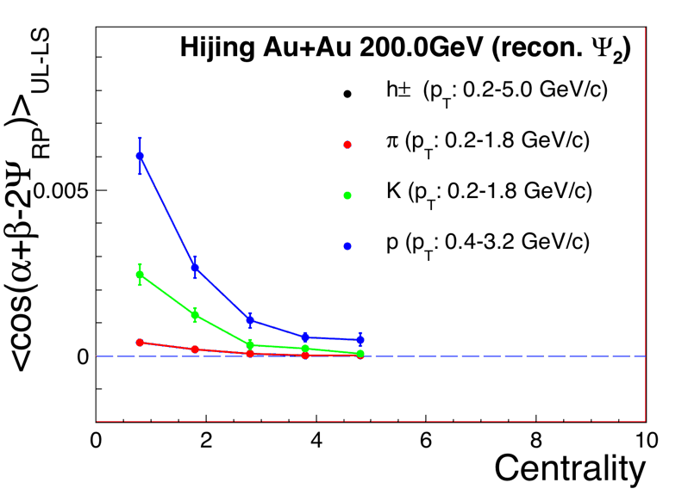
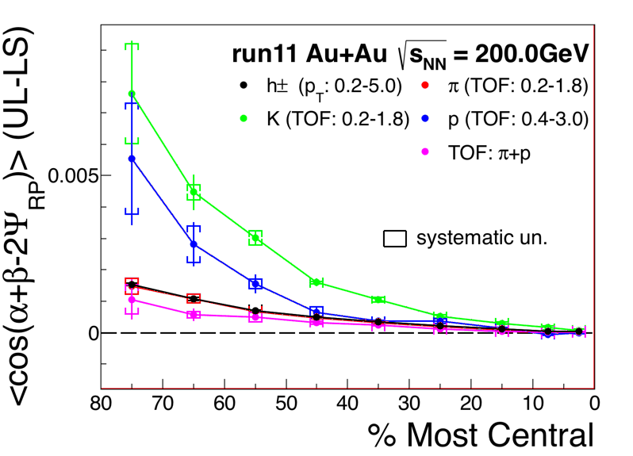
Backgrounds
Jet effects from Hijing simulation
Jie Zhao, FW, Hard Probes 2016
Hijing
No flow
Hijing
Flow afterburner
Signal is zero with default Hijing and the true reaction plane.
With reconstructed EP, signal in Hijing is finite, comparable to data.
w/ flow afterburner, signal is larger.
STAR preliminary

Slide 15
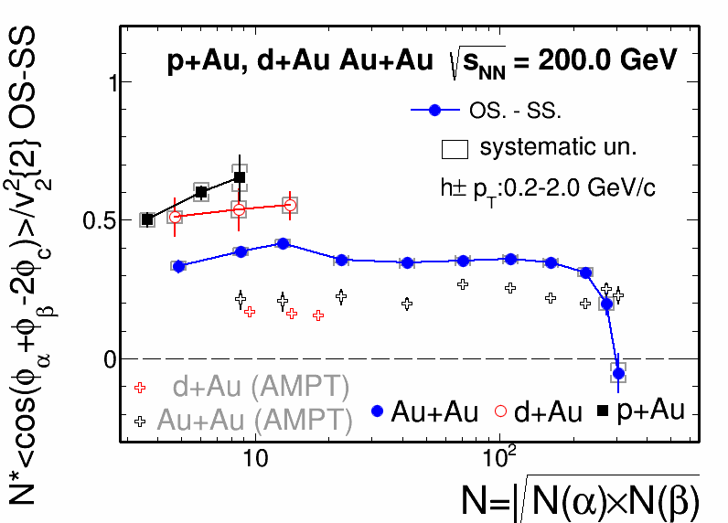
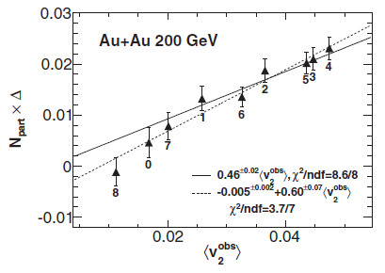
Ways to reduce backgrounds
Scale data with v2
Jie Zhao (STAR), QM 2017
Background: ~ v₂/N
Scale measurement by N/v₂
STAR, PRC 89, 044908 (2014)
Here Δ is similar to
cos(α+β−2ψ) correlator
Midcentral-central data scale like v₂/N, consistent with background scenario.
AMPT predicts ~2/3 of heavy ion data, ~1/3 of small system data.

Slide 16
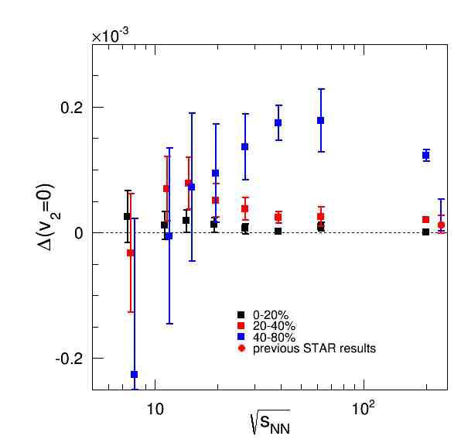
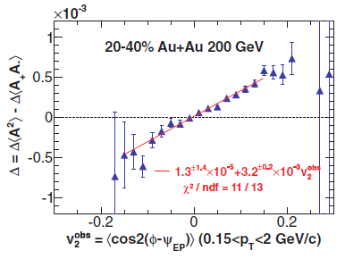
Suppress v2-driven background
Ways to reduce backgrounds
Clearly there are flow driven background contributions:
need to develop ways to suppress such backgrounds!
Attempt by STAR: Reconstruct EP in half-TPC, look at signal vs E-by-E v2-anisotropy of the other half. Linear fit and extract intercept at E-by-E measured v2=0.
Note: such attempt does not remove background completely.
FW, Jie Zhao, arXiv:1608.06610
STAR, PRC 89, 044908 (2014)
Biao Tu, QM 2015
STAR Preliminary
Here Δ is similar to cos(α+β−2ψ) correlator

Slide 17
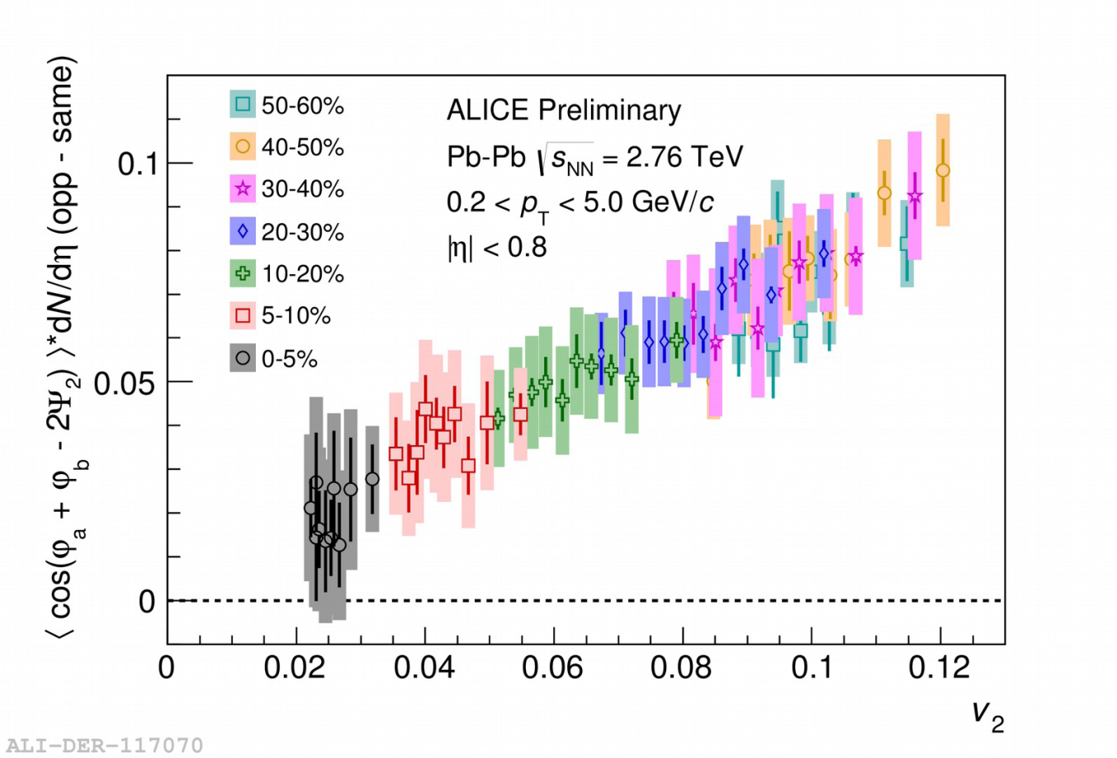
Event-shape engineering
Ways to reduce backgrounds
STAR, PRC 89, 044908 (2014)
Dobrin (ALICE),
QM 2017
Signal approximately scales with v₂ and multiplicity
→ mostly background contribution
Two-component fit: (1-x) * v₂/N + x* CME(B²(v₂))
→ CME contribution < 20% at 98% CL.

Slide 18
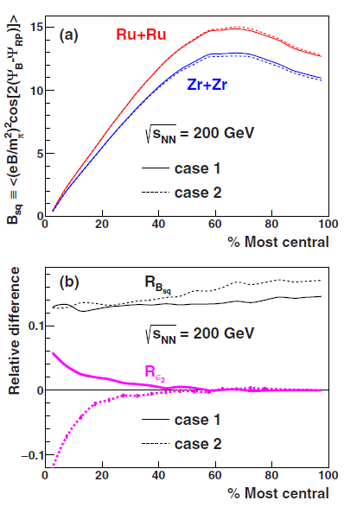
Ways to reduce backgrounds
Isobar collisions
Same atomic numbers, different proton numbers.
Magnetic effect differ by ~10%
Backgrounds differ by ~2%
Factor x5 improvement in signal/background ratio
Promising experimental discriminator
Deng et al. PRC 94 (2016) 041901(R)

Slide 19
Summary
Summary
CME is important physics in QCD
Major v₂-induced background in the 3-particle correlator. The small-system data helped sharpen our understanding.
  If background is major, it will be tough to convince ourselves and people outside the field.
  Innovative ways to reduce background
  New observables

Slide 20
backup

Slide 21
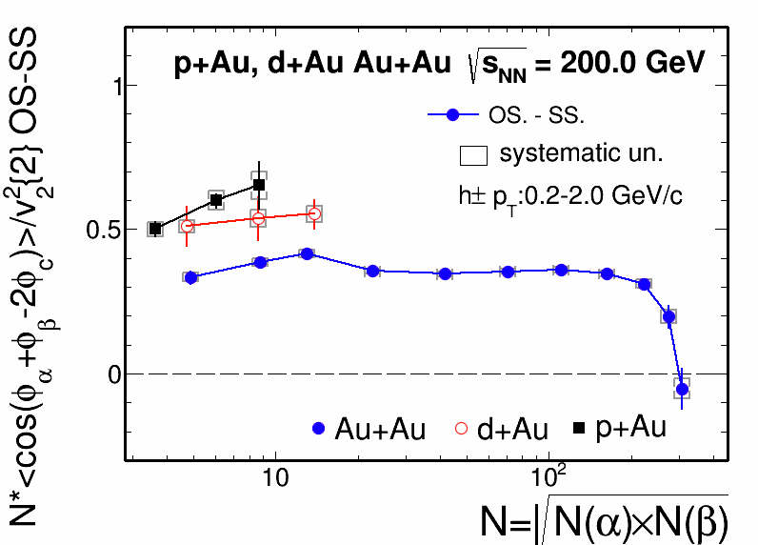
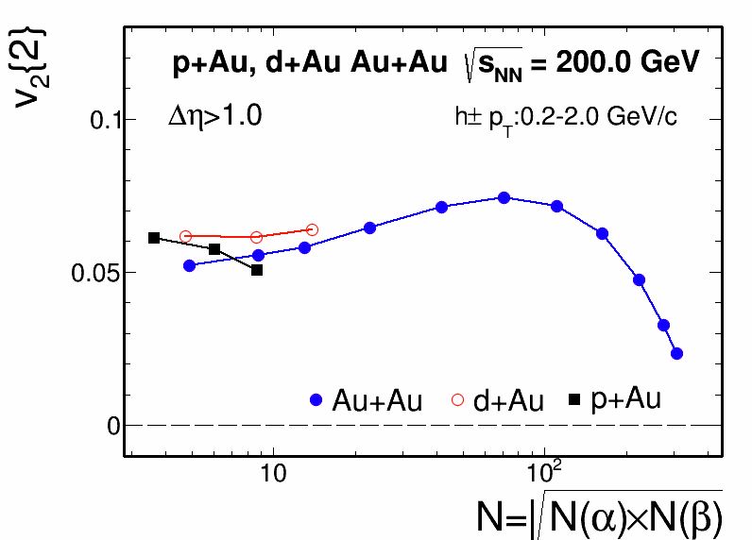
RHIC/STAR results
Jie Zhao for STAR, QM 2017
STAR preliminary
STAR preliminary
At same multiplicity d+Au and Au+Au show similar charge separation

Slide 22
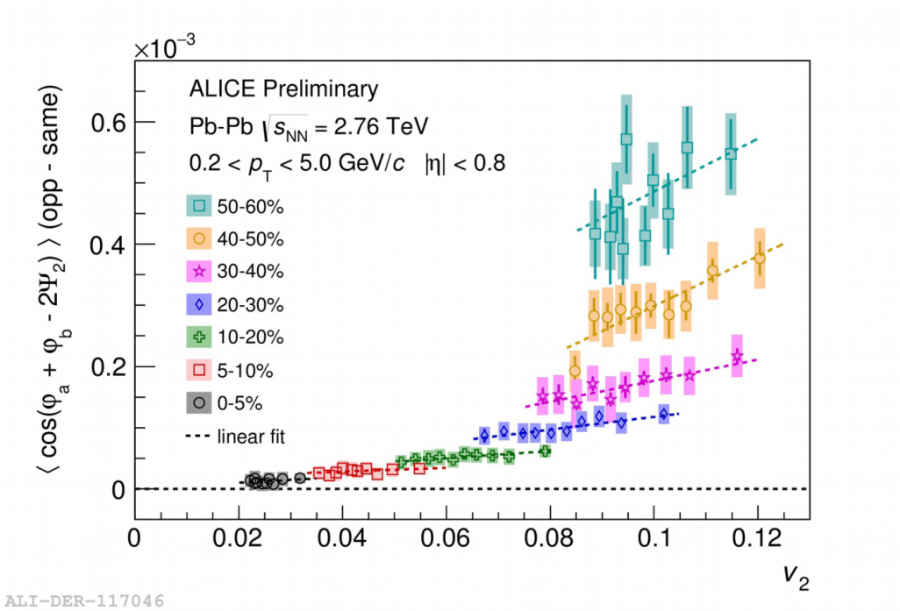
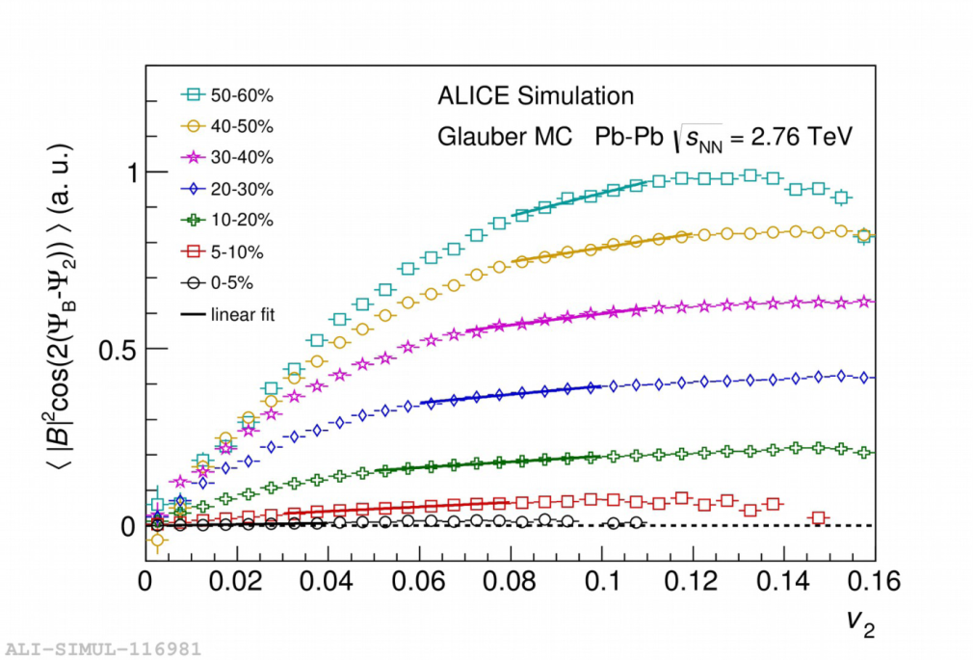
LHC/ALICE results
<|B|2cos(2(ΨB-Ψ2))> vs v2
f CME∗p1,MC+(1−f CME)∗1=p1,data
fCME (Glauber) = 0.102―0.129,
fCME (KLN) = 0.076―0.104 ,
fCME (EKRT) = 0.084―0.114

Slide 23
Resonances decay simulation
 | dN/dy | B.R.
ρ -> π⁺+π⁻ | ~16.7 | ~100%
η -> π⁺+π⁻+π⁰ | ~7.86 | ~22.9%
η -> π⁺+π⁻+γ | ~7.86 | ~4.2%
ω -> π⁺+π⁻+π⁰ | ~9.87 | ~89.2%
ω -> π⁺+π⁻ | ~9.87 | ~1.5%
STAR, Phys. Rev. C 92, 024912 (2015)
ρ/inclusive π ratio from STAR 40-80% ~0.169 for all centrality,
fixed ρ/η, ρ/ω ratio from the MB data.
consider ρ, η and ω to π contributions, fixed ρ/η, ρ/ω ratio.
total resonance/”direct” π ~0.39

Slide 24
Resonances decay simulation
Single π and ρ -> π⁺+π⁻, η -> π⁺+π⁻+π⁰, η -> π⁺+π⁻+γ,
ω-> π⁺+π⁻+π⁰ , ω-> π⁺+π⁻.
two-body/three-body phase space decay,
Breit-Wigner mass fun for η, ω, ρ .
π pt from PHENIX. ρ pt from STAR 40-80%, for all centrality.
η and ω same pt as ρ for all centrality, v₂ from the excepted NCQ fitted data.
π v₂ from STAR low pt + PHENIX high pt (only upto 50-60%, take same for 60-70%and 70-80%).
particle mult. for each centrality sampled by Poisson accord. to dN/dy, Flat rapidity (+/-1.5) (STAR acc. with pt>0.2 and |eta|<1).
ρ/π ratio from STAR 40-80% ~0.169 for all centrality, consider ρ, η and ω to π contributions, fixed ρ/η, ρ/ω ratio. total resonance/’direct” π ~0.39

Slide 25
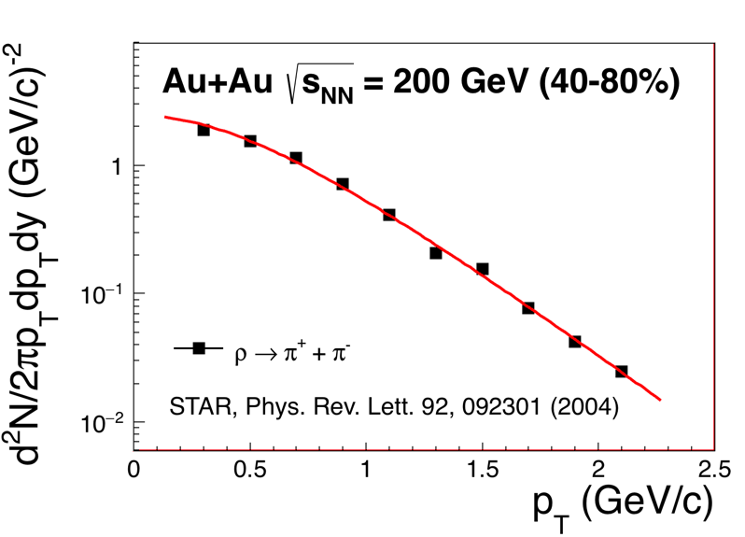

Rho p_{T} spectra
exponential mT fit
m₀)/T_{exp}
(m₀+T_{exp})
rho pt from STAR 40-80%, for all centrality. same shape for eta and oemga.
With fixed rho/inclusive pion =0.169, fixed eta/rho, omega/rho.

Slide 26
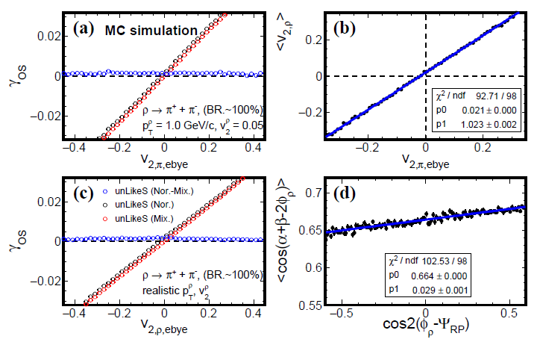
Event shape selection method does not completely eliminate background
Wang, Zhao, arXiv:1608.06610

