Slide 1
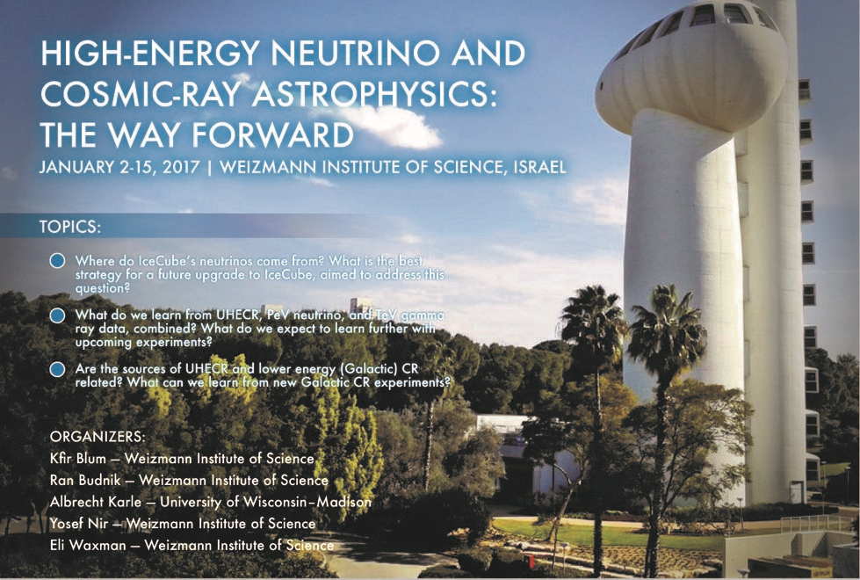

Slide 2
Our main goals
Discuss
The most important open questions,
The best experimental approaches for addressing them.
Identify discrepancies/open issues.
Direct discussions (in a politically calm environment).
Form small work groups to address specific issues.
Produce a “white paper”
Clear scientific case for next-generation experiments;
Coherent and well justified experimental road map;
Focus on HE ν & CR experiments, discuss HE γ & LE CR role/impact;
Aim to complete within 1-2months.

