Slide 1
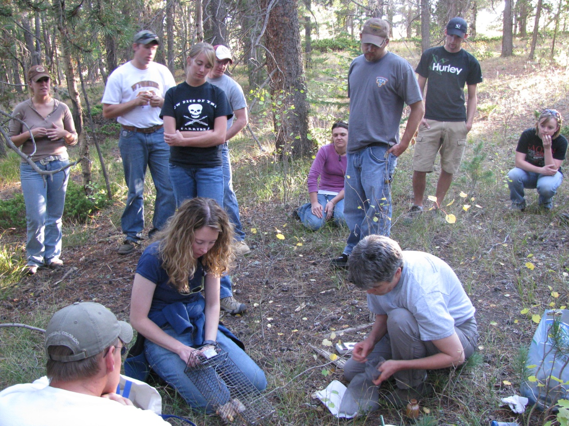
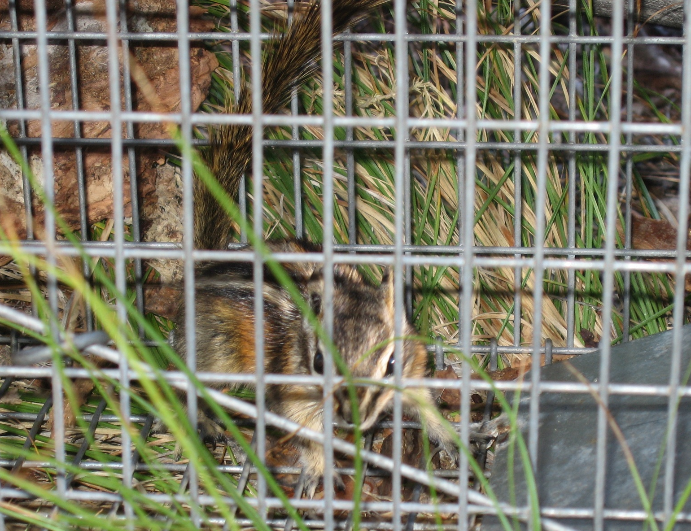
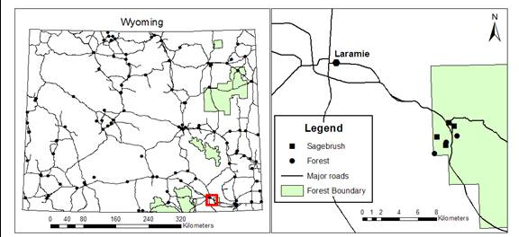
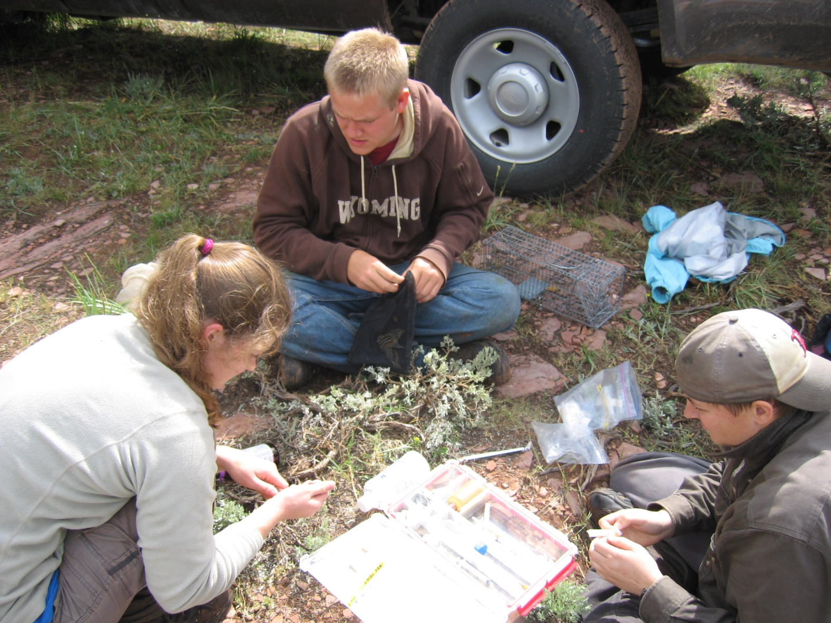
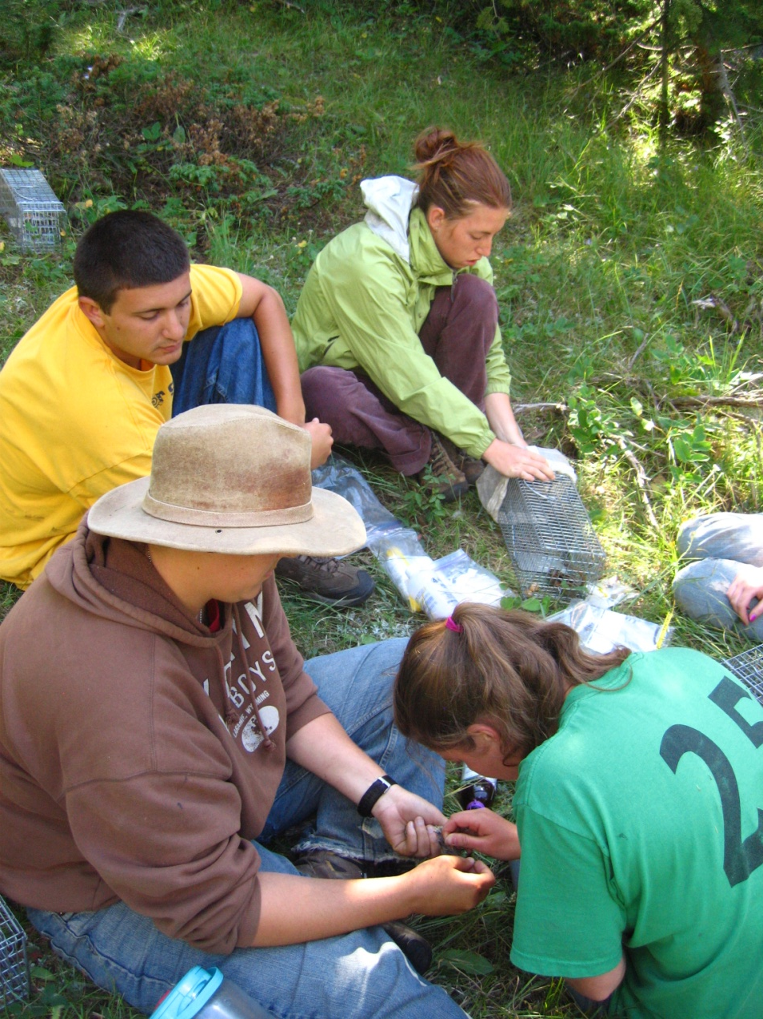
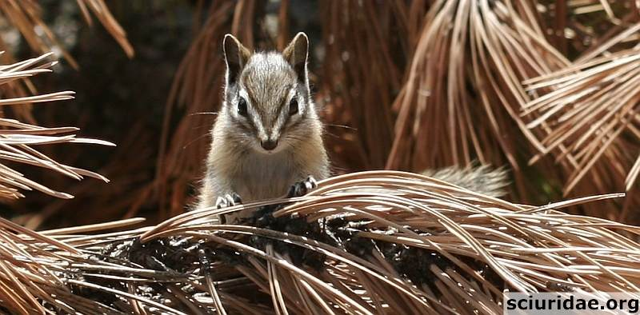
The impact of Field experience on students’ Conceptual Understanding of Climate Change
Jennifer H. Forrester¹, Sarah Walker², Elizabeth Flaherty³, and Merav Ben-David³
¹Elementary and Early Childhood Education, University of Wyoming. ²Science Math Teaching Center, University of Wyoming. ³ Department of Zoology and Physiology, University of Wyoming.
Study site
Field research was conducted in the Pole Mountain area of Southeast Wyoming over a three-week period in late summer and fall of 2012
Background:
Despite scientific evidence suggesting the link between climate change and greenhouse gases (IPCC 2007), many Americans, including college students, continue to express misconceptions about the phenomenon (Leiserowitz 2010). Researchers predict that interactions with scientists and the natural environment will increase knowledge and understanding (Leiserowitz, 2010). Providing such experiences is critical to enabling citizens to make informed decisions affecting their local and global community.
The lack of severe freezing periods in the Rocky Mountains has contributed to an unprecedented irruption of the mountain pine beetle, Dendroctonus ponderosae (Shuman 2011) and large expanses of tree mortality over the past 5-7 years. Since 2006, we used this ecological disturbance as an educational tool with the goal of introducing students to the science of climate change and its impact on ecological communities.
more students believed climate change was important to them personally (Q4; paired t-test, p = 0.02); more students responded that climate change is the most significant conservation challenge (Q6; p = 0.018); finally, the understanding that climate change influences bark beetle eruptions was intensified following the experience (Q10; p = 0.044, see Figure 1).
Q1
Q4
Q6
Q10
Table 1. Demographic data of students
82% of participants were Caucasian.
Project Objectives:
Collect long-term monitoring data on the effects of climate change on ecological systems.
Provide college students place-based experiences that encourage learning about climate change effects on ecological systems.
Document changes to conceptual understanding of climate change by students after participation in field research.
Identify activities that contribute to changes in conceptual understanding of climate change impacts.
 |  | Proportion of participants | Proportion of non-participants
Class | Seniors (3rd year) | 0.76 | 0.40
 | Juniors (4th year) | 0.24 | 0.30
 | Freshman (1st year)/ Sophomore (2nd year) | 0.00 | 0.30
Major | Wildlife | 0.68 | 0.40
 | Other | 0.32 | 0.60
Gender | Male | 0.57 | 0.50
 | Female | 0.43 | 0.50
Figure 2. Our findings suggest this field experience significantly affected students’ perceptions of the relevancy and importance of climate change This was evident from responses to 4 of 10 questions. Following participation more students felt they were better informed regarding climate change (Q1; paired t-test, p = 0.015);
Survey 37 participants (those enrolled in “Wildlife Ecology and Management”) and 19 non-participants (enrolled in “Fisheries Management”) before the activity.
Survey is voluntary!
35 participant students and 10 non-participants complete surveys (pre-survey)
Participants engage in:
- Establishing trapping grids
- Setting and checking traps
- Handling chipmunks (sedation, measurements, individual marking with PIT tags)
- Surveying vegetation (line transects and overstory cover estimation)
Responses to the survey questions coded with the 7-point Likert scale (1=strongly agree, 2= agree, 3=somewhat agree, 4=neutral, 5=somewhat disagree, 6=disagree, 7=strongly disagree).
Interview responses included statements such as:
“…it made it easier to learn in the classroom.”
“You’re not just using imaginary data that your teacher provided for you, you’ve actually went out and collected this information…”
“I think it makes you care about it a lot more. Actually doing the study in an area where you know like you go every day and you know what’s going on. If we just read a paper about it would I think I wouldn’t care as much if I just read a paper on a study than actually doing a study ourselves.”
Compare
(paired-sample statistics)
Figure 1. Responses of participants to all questions (except question 10) were similar to those of non-participants (t-test, p >0.18) suggesting they represent the total environmentally oriented student population at the University of Wyoming. They exhibited better knowledge of the relationship between climate change and bark beetle infestations than non-participants (t-test, p = 0.016), likely because non-participants were largely familiar with aquatic systems.
34 participants complete the same survey following the field project
(post-survey); only 32 also completed pre-survey.
Participants use chipmunk experience in classroom and lab:
Analyze field data
Review literature
Help prepare grad student presentation
19 participants are interviewed following the post survey
1
2
3
4
5
Funding was provided by the Wyoming Governor's Big Game License Coalition, the Wyoming Wildlife – The Foundation, The University of Wyoming College of Arts and Sciences, Department of Zoology and Physiology, EPSCoR Undergraduate Research Program, Wyoming NASA Space Grant Consortium, and the UW Science Posse
References
Intergovernmental Panel on Climate Change. 2007a. Climate change 2007: The physical
science basis. Geneva: IPCC. www.ipcc.ch.
Leiserowitz, A., N. Smith, and J.R. Malon. 2010. . Yale University, New Haven, CT: Yale Project on Climate Change Communication. http://environment.yale.edu/climate/files/ClimateChangeKnowledge2010.pdf Accessed 16 July 2012.
Shuman, B. 2012. Recent Wyoming temperature trends, their drivers, and impacts in a 14,000-year context. Climatic Change 112, no.2: 429-447.

